Slide 1

Team Details
Team name: Assassin
Team leader name: Arya Y P
Problem Statement: Financial Health Score

Slide 2
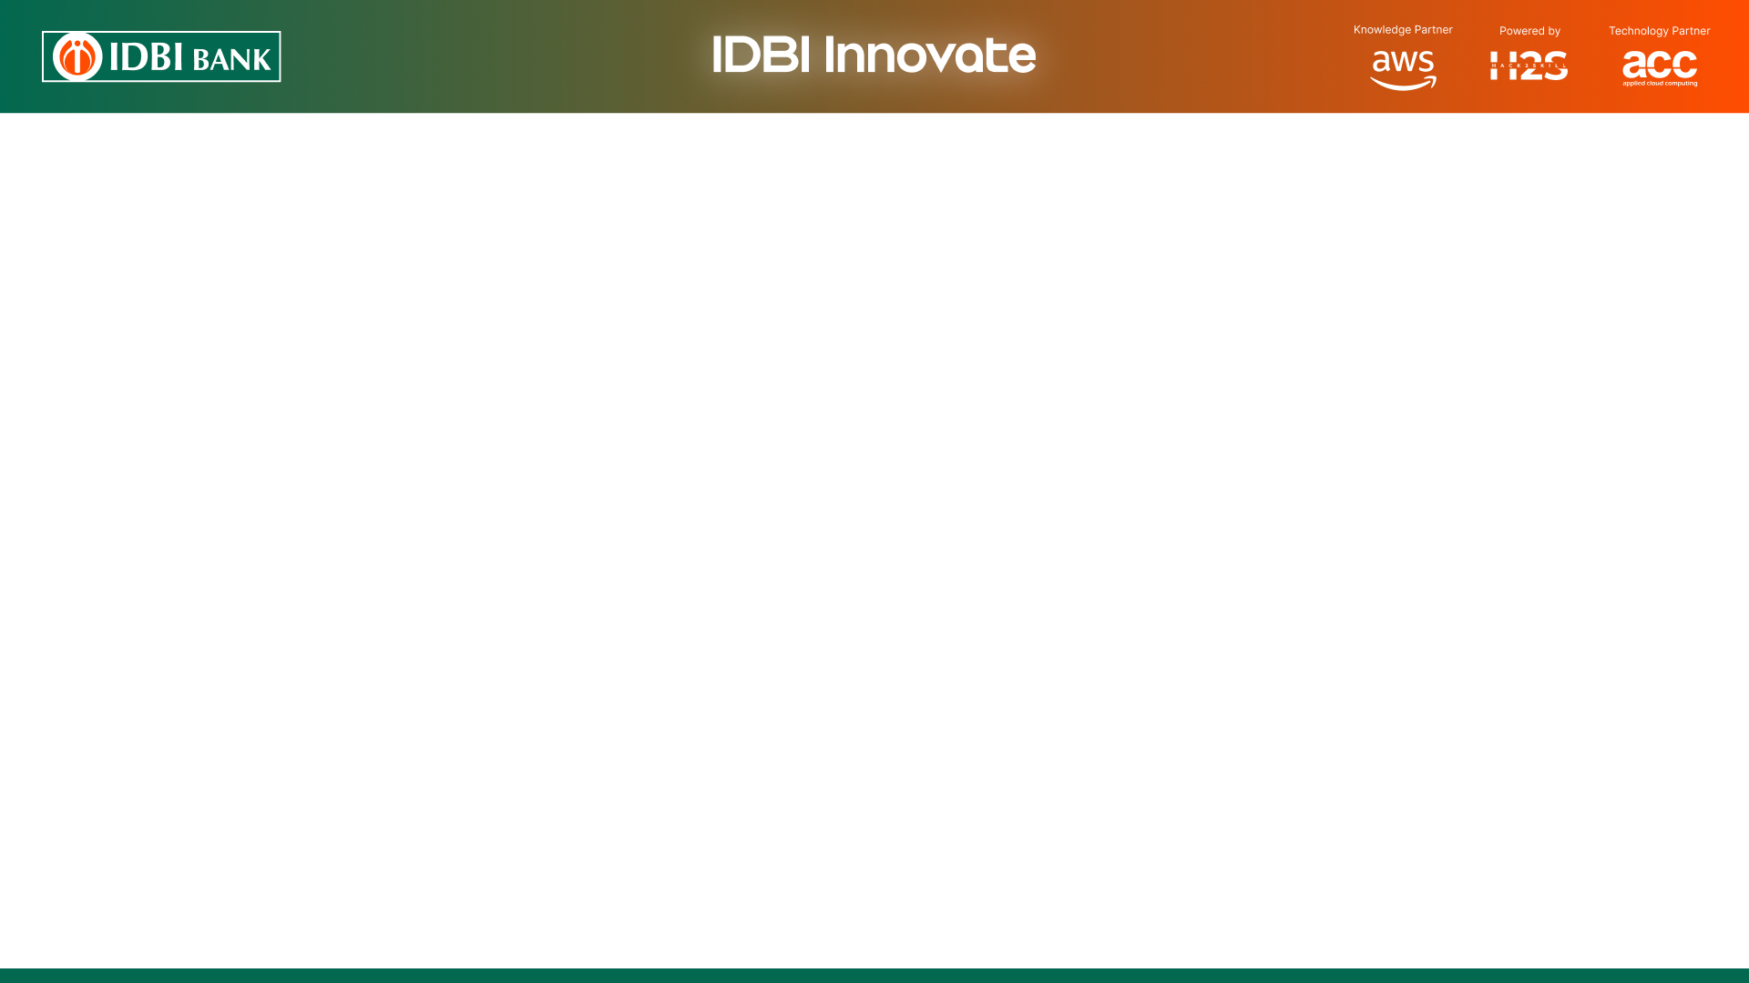
Brief about the idea
Underwrite the credit-invisible MSME.
An AI/ML-driven credit assessment platform that scores New-to-Credit and New-to-Bank MSMEs from consented alternate data — GST, Account Aggregator, EPFO and UPI — via an explainable, six-dimension health score with an ML second opinion.
Built consent-first and ULI/OCEN-ready so every rail a real integration would use is already modelled.
WHAT ONE CARD HOLDS
GST 24 months of returns · filing discipline
AA 12 months of bank txns · DSCR proxy
EPFO Headcount trend · salary regularity
UPI Volume · breadth · P2M share
→ Composite 0–1000 · Band A/B/C/D · Approve · Refer · Decline

Slide 3
Opportunities
1
How is it different?
2
How does it solve the problem?
3
USP
• Bureau-independent by design — scores from live rails, not stale bureau files.
• Six explainable dimensions, not one opaque number.
• ML PD prediction runs alongside the rulebook as a second opinion, with per-feature counterfactual explanations.
• Aggregates GST + AA + EPFO + UPI into one normalised data pack via consented pulls.
• Every factor lands in a named dimension with a signed point contribution — the underwriter can defend every rupee sanctioned.
• Onboarding, decisioning and sanction happen in one flow — near real-time.
• NTC uplift: a 10-month-old startup with no bureau footprint scores Band A on cash-flow and compliance signals alone.
• Consent-first: every pull is registered, validated, revocable and audited.
• Before/after impact view quantifies the additional MSMEs served versus a bureau-only lender — with the approved book carrying a lower average PD (29% → 15%).

Slide 4
List of features offered by the solution
1
6 scored dimensions
Revenue Health, Cash-Flow, Digital Vitality, Compliance, Employment, Obligation & Leverage. Factor-decomposed with signed contributions and stable reason codes.
2
ML second opinion
Calibrated, monotonic HistGB trained on the production feature pipeline. 12-month PD, counterfactual drivers, holdout AUC & Brier, agreement flag.
3
Consent-first pulls
AA-style grants validated on every fetch, revocable live. Unshared rails are never fetched. Grant + access audit logs.
4
Portfolio dashboard
30-MSME book: EWS badges, watch-list actions, concentration guardrails, vintage cohorts, ML-divergence queue, stress tests.
5
Before/after impact
Coverage, exposure and NTC/NTB inclusion vs a bureau-only lender — plus a computed PD comparison of the two approved books.
6
ULI / OCEN simulator
LSP → ULI → BANK → AA → FIP round-trip carrying the real consent handle and record counts per hop, plus the actual health-card / sanction produced.
7
Loan application + sanction
One-click apply → auto-sanction if APPROVE → printable letter with EMI, covenants and an RBI-DLG Key Fact Statement.
8
Borrower recommendations
“Do X → gain ~Y pts” actions with uplifts computed by re-running the scorecard, stacked into a path to the next band.
9
Benchmarks · history · what-if
Percentile chips, observed-vs-reconstructed score history, and a live what-if simulator on every card.

Slide 5
Process flow diagram or Use-case diagram
1
2
3
4
5
6
Onboard
Consent
Data pull
Score
Decide
Sanction
Officer picks / MSME lands on tile
AA-style handle issued, per-source
GST + AA + EPFO + UPI normalised
6 dims → composite → ML PD
APPROVE / REFER / DECLINE + limit
Application + printable letter
Every hop is auditable. Consent is registered up front and validated on every downstream pull — unknown / revoked / expired handles are rejected with 403. Data pulls return in seconds; the composite score, ML PD and full explanation are all generated on-demand from the same request.

Slide 6
Wireframes/Mock diagrams of the proposed solution (optional)
msme-frontend-kahy.onrender.com / landing
msme-frontend-kahy.onrender.com / consent
Landing · 5-persona picker + hero
Consent · Source-by-source flow
▸ Track 03 header pill
▸ Bold ‘credit-invisible’ headline
▸ 5 MSME tiles → open Consent
▸ GST · AA · EPFO · UPI toggles
▸ Real /data-pack call on grant
▸ Per-source Fetched / Queued chips
msme-frontend-kahy.onrender.com / health-card
msme-frontend-kahy.onrender.com / portfolio-impact-ecosystem
Health Card · Officer / Borrower toggle
Portfolio + Impact + Ecosystem · Officer dashboards
▸ Score dial + risk band + recommendation
▸ Radar + score-history chart
▸ Decision panel + limit workings + Apply CTA
▸ ML second-opinion panel with drivers/supports
▸ 30-MSME book — trend, EWS, watch-list
▸ Impact: traditional vs alternate mix
▸ ULI / OCEN wire-timeline simulator

Slide 7
Architecture diagram of the proposed solution
1
Presentation (Vite + React + Tailwind)
Landing · Consent · HealthCard · Portfolio · Impact · Ecosystem · Sanction · Consent-log
2
API (FastAPI on Uvicorn)
/msme · /consent · /data-pack · /health-card · /what-if · /portfolio · /stress · /impact · /uli · /ocen · /audit · /compliance
3
Domain (scoring + ML)
features → 6 dimensions → composite → decision → recommendations · calibrated HistGB PD + counterfactual explainer · benchmarks · portfolio · stress · impact · ecosystem · applications · consent · audit
4
Connectors (Protocol contracts, mock impls)
Identity · Gst · Aa · Epfo · Upi · Bureau (display-only stub) connectors — swap-in ready for real GSTN / AA / EPFO / NPCI / bureaus
5
Rails (consent-first, ULI/OCEN-ready)
AA consent artefacts · GSTN GSTR-1/3B pulls · EPFO establishment fetches · UPI acquirer feed

Slide 8
Technologies to be used in the solution
Frontend
Backend
Rails / Deploy
React 18
UI framework
FastAPI
REST + OpenAPI
AA (ReBIT FI shape)
Consent + bank data
Vite 5
Dev server + build
Uvicorn
ASGI server
GSTN GSTR-1 / 3B
Filing history
TypeScript 5
Type-safe UI
Pydantic v2
Schemas + validation
EPFO extract
Payroll / headcount
Tailwind 3
Utility CSS
scikit-learn 1.4
HistGradientBoosting
UPI acquirer feed
Merchant receipts
Recharts
Radar / line / area charts
NumPy
Feature vectors
Render
Blueprint deploy
React Router 6
SPA routing
Python 3.11
Runtime
Git + GitHub
Source + CI

Slide 9
Estimated implementation cost (optional)
PROTOTYPE (BUILT)
₹0 demo cost
Runs entirely on free tiers:
· Render — free web + static site
· FastAPI + scikit-learn — open-source
· Vite + React + Tailwind — open-source
· 30-MSME synthetic portfolio in-process
· No external API charges
PRODUCTION (INDICATIVE, ₹ p.a.)
AA licensing (RBI-regulated FIU)
₹15–25 L
GSTN Suvidha Provider integration
₹8–12 L
EPFO + UPI feed onboarding
₹4–6 L
Cloud infra (Postgres + workers)
₹6–10 L
Model ops (retrain + monitor)
₹4–6 L
Security audit / RBI compliance
₹8–12 L
Year-one estimate
₹45–70 L

Slide 10
Snapshots of the prototype
Health Card — NewGen Tech (NTC, Band A)
composite 835 / 1000
Health Card — Kumar Enterprises (Band D)
composite 363 / 1000
Risk band: A · Prime
Decision: APPROVE · ₹34.7 L · 36 mo · 10.5%
ML PD: 2.9% · agrees with rulebook
Trend: improving
Risk band: D · High risk
Decision: DECLINE
ML PD: 95.1% · agrees with rulebook
Drivers: 4 bounces · GST 62.5% on time
Portfolio dashboard
30 MSMEs · officer view
Impact — before vs after
traditional vs alternate
Bands: A=10 · B=12 · C=3 · D=5
Trend: ↑12 · →13 · ↓5
Watch-list: 17 flagged
NTC / NTB served: 12 firms
Approval coverage: 33% → 70%
NTC/NTB onboarded: 0 → 12
Exposure: ₹2.56 Cr → ₹6.47 Cr
Additional served: +17 MSMEs

Slide 11
Prototype Performance report/Benchmarking
0.3 s
Warm model load
cold train ~7 s
<0.3 s
Full card via API
incl. ML + history
70%
Approval coverage
vs 33% bureau-only
+₹2.6 Cr
Exposure unlocked
extra ₹ served in the book
Persona scores (deterministic per GSTIN)
Model + reproducibility
✓ 18-feature vector, canonical order pinned in code
✓ 80/20 hold-out AUC 0.89 + Brier 0.115 on every card
✓ Platt-calibrated PDs · monotonic constraints, all 18 features
✓ Local counterfactual explainer — top-3 up / down
✓ Same GSTIN → same score (GSTIN-seeded RNGs)
✓ Model persisted by version hash — warm boots load in 0.3 s
Sharma Textiles
894
A
APPROVE
NewGen Tech (NTC)
835
A
APPROVE
Meera Handicrafts
709
B
APPROVE
Kirana Bazaar
699
B
APPROVE
Kumar Enterprises
363
D
DECLINE

Slide 12
Additional Details/Future Development (if any)
1
Real rails integration
Move behind live GSTN Suvidha Provider, RBI-regulated Account Aggregator, EPFO + NPCI feeds. Protocol seams already there.
2
Bureau-if-available adapter
Stub already built — NTC shows “no bureau file” on the card. Production adapter layers a real file in without displacing alternate signals.
3
ITR + Udyam verify + utility
Add ITR as a 5th source and Udyam KYC / utility payment feeds for the ‘etc.’ in the problem statement.
4
Portfolio monitoring service
Continuous scoring on live pulls — daily deltas + drift alerts on top of the stress tests and watch-list actions already built.
5
Model ops
Retrain on real default outcomes as they arrive · monitor calibration drift · A/B challenger scorecards · fairness audits.
6
Borrower-side
Vernacular UI · WhatsApp status updates · improvement tracker so an MSME sees exactly how each action moved the score.

Slide 13
Provide links to your:
• GitHub Public Repository — https://github.com/Arya-126/idbi
• Demo Video Link (3 Minutes) — https://drive.google.com/... (to be added by team)
• Final Product Link — https://msme-frontend-kahy.onrender.com · backend: https://msme-backend-un24.onrender.com/docs

Slide 15


